Slide 1

Naive Bayes Classification based Optimization
JSS Academy of Technical Education
Department of Computer Science and Engineering
2021 - 2022
Team members name
1.Aditya Rastogi
2.Bharadwaj A
3.Jyothi L
4.Amit

Slide 2
Contents
Introduction
Existing technique and its drawbacks
Objectives and proposed system
Methodology and Design
Conclusion and Future Scope
References
Department of CSE

Slide 3
Introduction
The Internet is an important source of information, where the amount of data is vast and constantly growing.
Users rely on search engines to find specific information in this knowledge base.
Search engines perform well in indexing web pages and providing users with relevant content to their search but are not suited for non-factual questions
Department of CSE

Slide 4
Existing technique and its drawbacks
When a user intends to answer a question, (s)he may be overwhelmed by the plethora of questions.
Current Q&A systems may not meet the requirement of providing high quality answer with a short answer wait time, though users wish to receive satisfactory answers quickly.
The privacy of the Q&A system is very important nowadays.
Department of CSE

Slide 5
Objectives and proposed system
We propose Social Q&A, an online social network based Q&A system, that actively forwards questions to those users with the highest likelihood (capability and willingness) of answering them with expertise and interest in the questions’ subjects.
Social Q&A favors routing queries among friends and identifies a question’s potential answerers by considering two metrics: the interest of the friend towards the question and the social closeness of the friend to the asker/forwarder.
Department of CSE

Slide 6
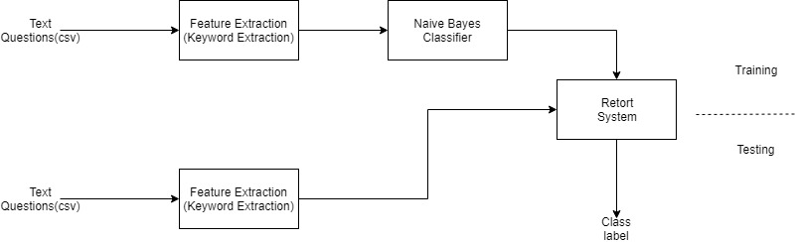
Methodology and Design
METHODOLOGY
Department of CSE

Slide 7
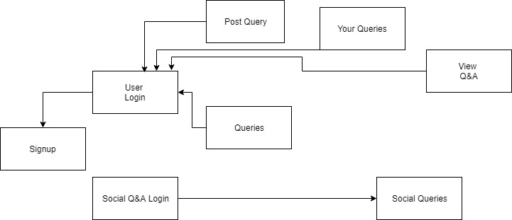
CLASS DIAGRAM
Department of CSE

Slide 8
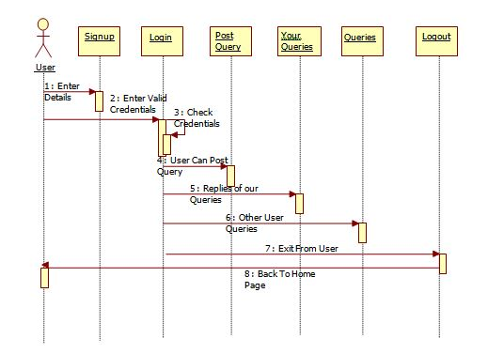
USER SEQUENCE DIAGRAM
Department of CSE

Slide 9
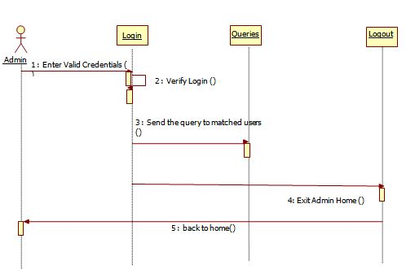
ADMIN SEQUENCE DIAGRAM
Department of CSE

Slide 10
Conclusion and Future Scope
CONCLUSION
Q&A systems are used by many people for purposes such as information retrieval, academic assistance, and discussion. To increase the quality of answers received and decrease the wait time for answers, we have developed and prototyped an online social network based Q&A system.
It utilizes the properties of a social network to forward a question to potential answer providers, ensuring that a given question receives a high-quality answer in a short period of time.
It removes the burden from answer providers by directly delivering them the questions they might be interested in.
Department of CSE

Slide 11
FUTURE SCOPE
Other techniques such as topic modeling and word embedding can be incorporated to find redundant question with a large scale user set.
The question forwarding process can be automated to directly forward the questions to the interested friends without the interaction of the admin
Department of CSE

Slide 12
Questionnaire
?
Department of CSE

Slide 13

Department of CSE

